Slide 1
Background Tasks
Android Developer Fundamentals
Lesson 8
This work is licensed under a Creative Commons Attribution-NonCommercial 4.0 International License

Slide 2
8.3 Transferring Data Efficiently & Job Scheduler
This work is licensed under a Creative Commons Attribution-NonCommercial 4.0 International License

Slide 3
Contents
Transferring Data Efficiently
Job Scheduler
JobService
JobInfo
JobScheduler

Slide 4
Transferring Data Efficiently

Slide 5
Transferring data uses resources
Wireless radio uses battery
Device runs out of battery
Need to let device charge
Transferring data uses up data plans
Costing users real money (for free apps…)

Slide 6
Wireless radio power states
Full power—Active connection, highest rate data transfer
Low power—Intermediate state that uses 50% less power
Standby—Minimal energy, no active network connection

Slide 7
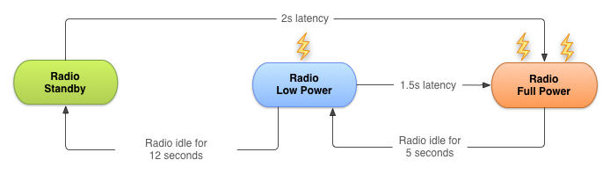
Wireless radio state transitions for 3G

Slide 8
Bundle network transfers
For a typical 3G device, every data transfer session, the radio draws energy for almost 20 seconds
Send data for 1s every 18s—radio mostly on full power
Send data in bundles of 3s—radio mostly idle
Bundle your data transfers

Slide 9
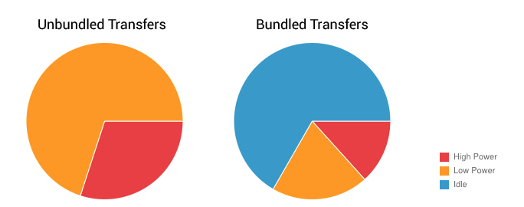
Bundled vs. unbundled

Slide 10
Prefetch data
Download all the data you are likely to need for a given time period in a single burst, over a single connection, at full capacity
If you guess right, reduces battery cost and latency
If you guess wrong, may use more battery and data bandwidth

Slide 11
Monitor connectivity state
WiFi radio uses less battery and has more bandwidth than wireless radio
Use ConnectivityManager to determine which radio is active and adapt your strategy

Slide 12
Monitor battery state
Wait for specific conditions to initiate battery intensive operation
BatteryManager broadcasts all battery and charging details in a broadcast Intent
Use a BroadcastReceiver registered for battery status actions

Slide 13
Job Scheduler

Slide 14
What is Job Scheduler
Used for intelligent scheduling of background tasks
Based on conditions, not a time schedule
Much more efficient than AlarmManager
Batches tasks together to minimize battery drain
API 21+ (no support library)

Slide 15
Job Scheduler components
JobService—Service class where the task is initiated
JobInfo—Builder pattern to set the conditions for the task
JobScheduler—Schedule and cancel tasks, launch service

Slide 16
JobService

Slide 17
JobService
JobService subclass
Override
onStartJob()
onStopJob()
Runs on the main thread
Notes:
off load your work

Slide 18
onStartJob()
Implement work to be done here
Called by system when conditions are met
Runs on main thread
Off-load heavy work to another thread

Slide 19
When does a JobService finish?
onStartJob() returns a boolean
FALSE—Job finished
TRUE
Work has been off-loaded
Must call jobFinished() from the worker thread
pass in JobParams object from onStartJob()
Notes:
Talk about rescheduling with jobfinished

Slide 20
onStopJob()
Called if system has determined execution of job must stop
… because requirements specified no longer met
For example, no longer on WiFi, device not idle anymore
Before jobFinished(JobParameters, boolean)
Return TRUE to reschedule

Slide 21
Basic JobService code
public class MyJobService extends JobService { private UpdateAppsAsyncTask updateTask = new UpdateAppsAsyncTask(); @Override public boolean onStartJob(JobParameters params) { updateTask.execute(params); return true; // work has been offloaded }
@Override
public boolean onStopJob(JobParameters jobParameters) {
return true;
}
}

Slide 22
Register your JobService
<service
android:name=".NotificationJobService"
android:permission=
"android.permission.BIND_JOB_SERVICE"/>

Slide 23
JobInfo

Slide 24
JobInfo
JobInfo
Set conditions of execution
JobInfo.Builder object

Slide 25
JobInfo builder object
Arg 1: Job ID
Arg 2: Service component
Arg 3: JobService to launch
JobInfo.Builder builder = new JobInfo.Builder( JOB_ID, new ComponentName(getPackageName(), NotificationJobService.class.getName()));

Slide 26
Setting conditions
setRequiredNetworkType(int networkType)
setBackoffCriteria(long initialBackoffMillis, int backoffPolicy)
setMinimumLatency(long minLatencyMillis)
setOverrideDeadline(long maxExecutionDelayMillis)
setPeriodic(long intervalMillis)
setPersisted(boolean isPersisted)
setRequiresCharging(boolean requiresCharging)
setRequiresDeviceIdle(boolean requiresDeviceIdle)

Slide 27
setRequiredNetworkType()
setRequiredNetworkType(int networkType)
NETWORK_TYPE_NONE—Default. No network required
NETWORK_TYPE_ANY
NETWORK_TYPE_NOT_ROAMING
NETWORK_TYPE_UNMETERED

Slide 28
setBackOffCriteria()
setBackoffCriteria(long initialBackoffMillis, int backoffPolicy)
How soon to reschedule if task fails
Arg 1: Initial time to wait after the task fails—default 30s
Arg 2: How long to wait subsequently
BACKOFF_POLICY_LINEAR
BACKOFF_POLICY_EXPONENTIAL
Default {30 seconds, Exponential}

Slide 29
setMinimumLatency()
setMinimumLatency(long minLatencyMillis)
Minimum milliseconds to wait before completing task

Slide 30
setOverrideDeadline()
setOverrideDeadline(long maxExecutionDelayMillis)
Maximum milliseconds to wait before running the task, even if other conditions aren't met

Slide 31
setPeriodic()
setPeriodic(long intervalMillis)
Repeats task after a certain amount of time
Pass in repetition interval
Mutually exclusive with minimum latency and override deadline conditions
Task is not guaranteed to run in the given period

Slide 32
setPersisted()
setPersisted(boolean isPersisted)
Sets whether the job is persisted across system reboots
Pass in True or False
Requires RECEIVE_BOOT_COMPLETED permission

Slide 33
setRequiresCharging()
setRequiresCharging(boolean requiresCharging)
Whether device must be plugged in
Pass in true or false
Defaults to false

Slide 34
setRequiresDeviceIdle()
setRequiresDeviceIdle(boolean requiresDeviceIdle)
Whether device must be in idle mode
Idle mode is a loose definition by the system, when device is not in use, and has not been for some time
Use for resource-heavy jobs
Pass in true or false. Defaults to false

Slide 35
JobInfo code
JobInfo.Builder builder = new JobInfo.Builder( JOB_ID, new ComponentName(getPackageName(), NotificationJobService.class.getName()))
.setRequiredNetworkType(JobInfo.NETWORK_TYPE_UNMETERED)
.setRequiresDeviceIdle(true)
.setRequiresCharging(true);
JobInfo myJobInfo = builder.build();

Slide 36
JobScheduler

Slide 37
Scheduling the job
Obtain a JobScheduler object form the system
Call schedule() on JobScheduler, with JobInfo object
mScheduler =
(JobScheduler)getSystemService(JOB_SCHEDULER_SERVICE);
mScheduler.schedule(myJobInfo);

Slide 38
Resources
Transferring Data Without Draining the Battery Guide
Optimizing Downloads for Efficient Network Access Guide
Modifying your Download Patterns Based on the Connectivity Type Guide
JobScheduler Reference
JobService Reference
JobInfo Reference
JobInfo.Builder Reference
JobParameters Reference
Presentation on Scheduling Tasks

Slide 39
What's Next?
Concept Chapter: 8.3 C Transferring Data Efficiently
Practical: 8.3 P Job Scheduler

Slide 40
END

